Slide 1
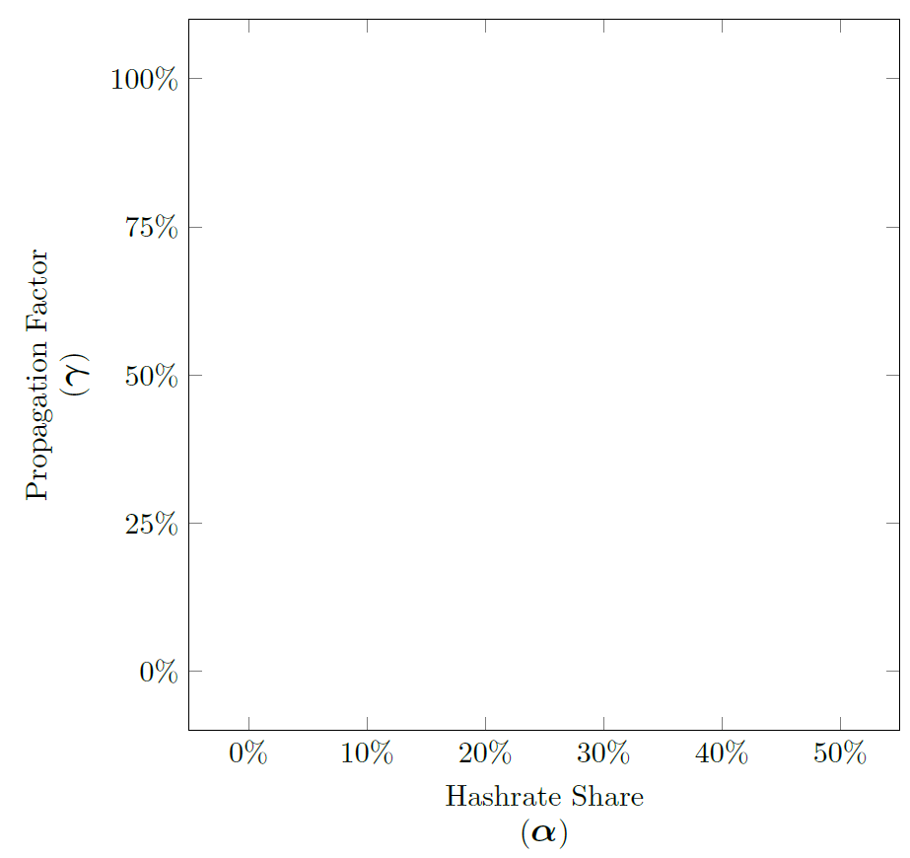


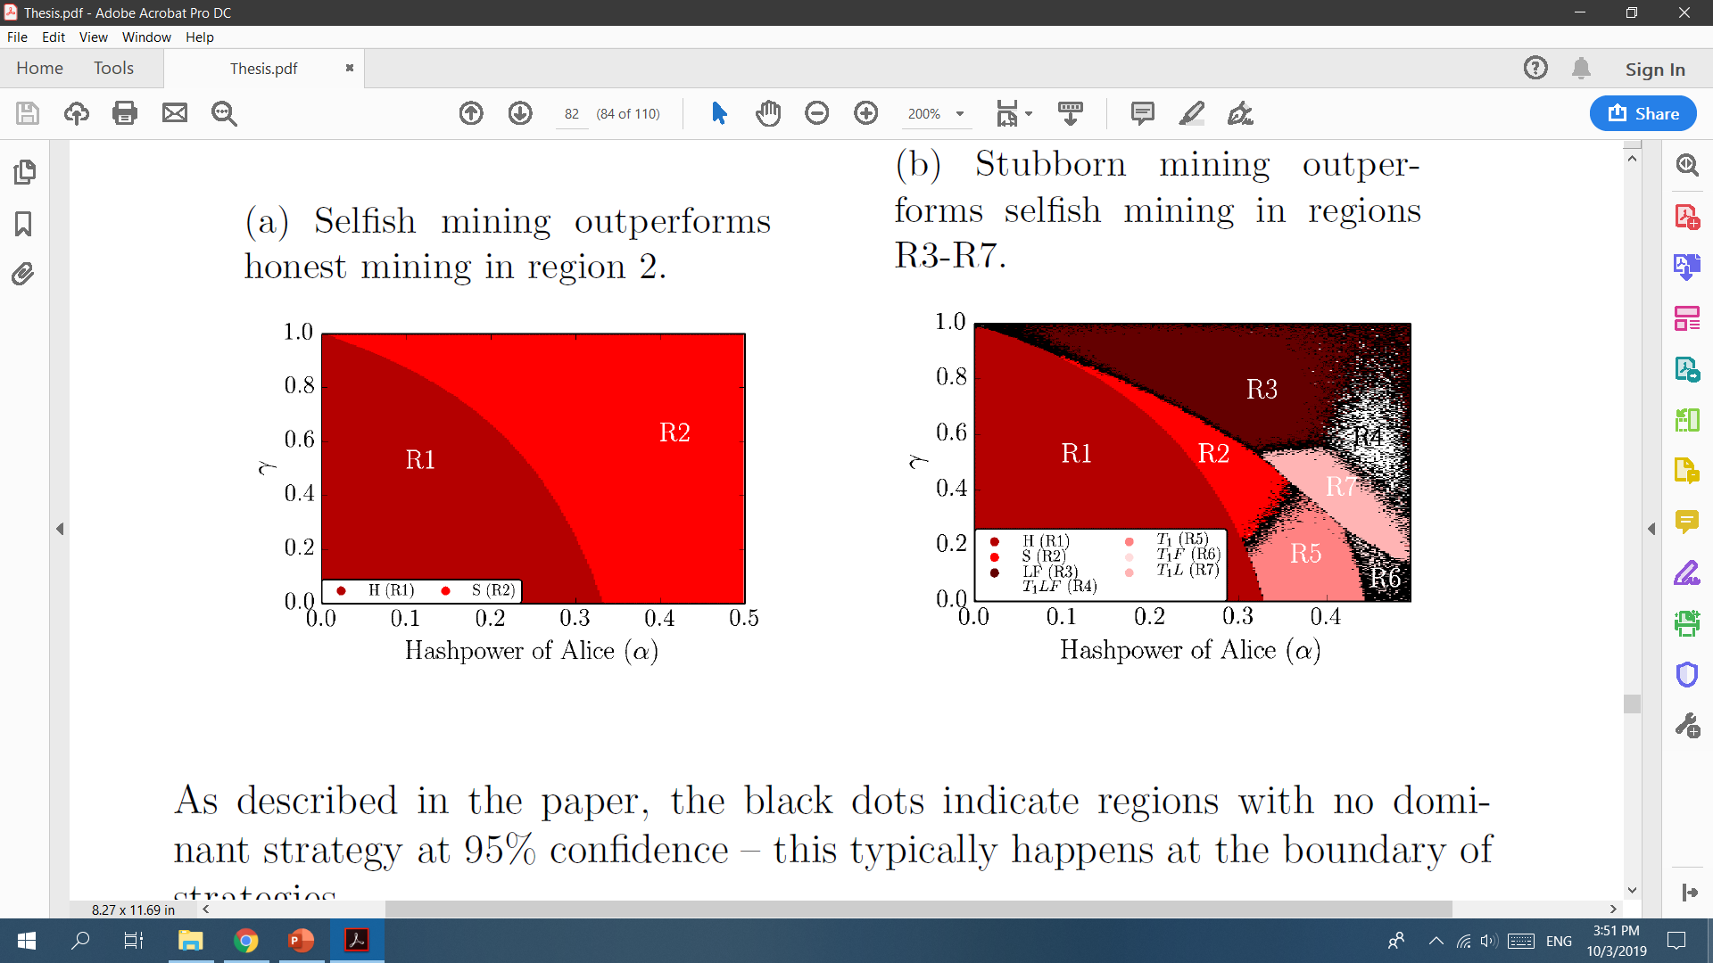
Peer-to-peer Network Simulation
Finite-State Machine Simulation
Expected
H
S
L
T2
T3
T4
E

Slide 2
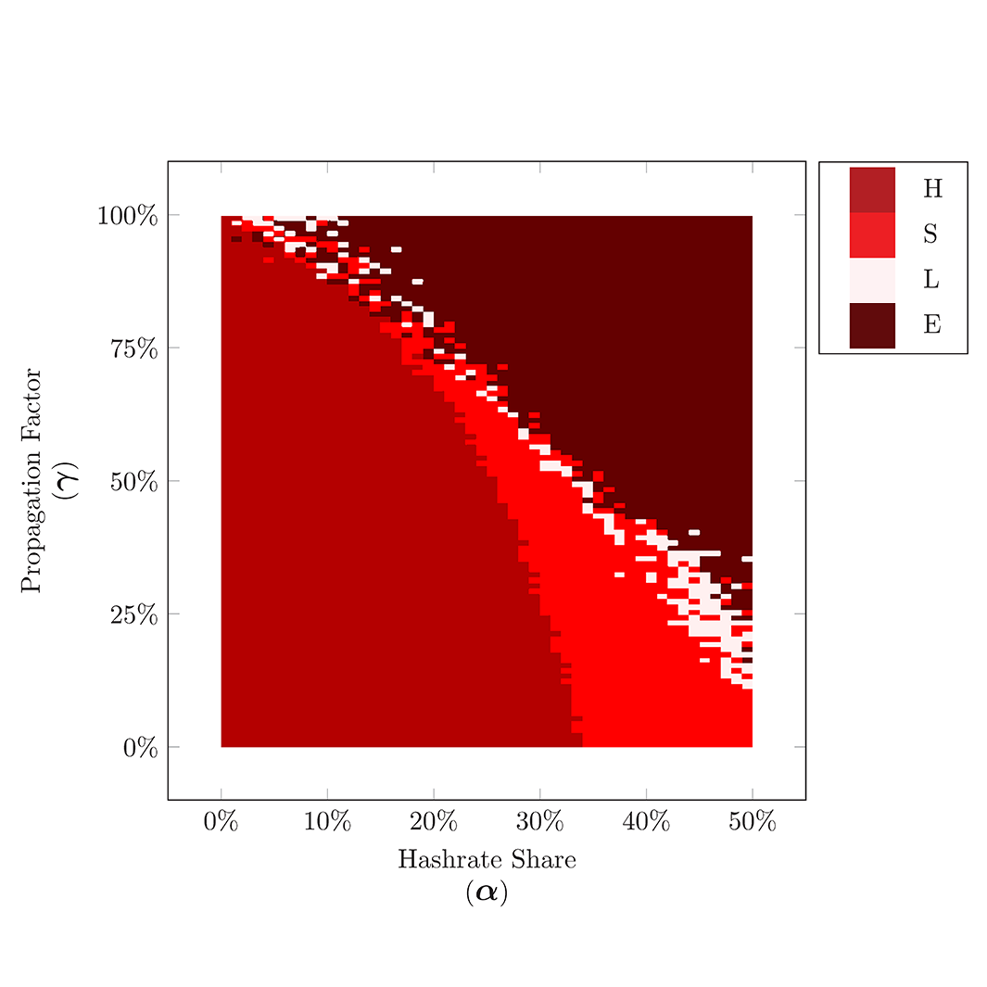
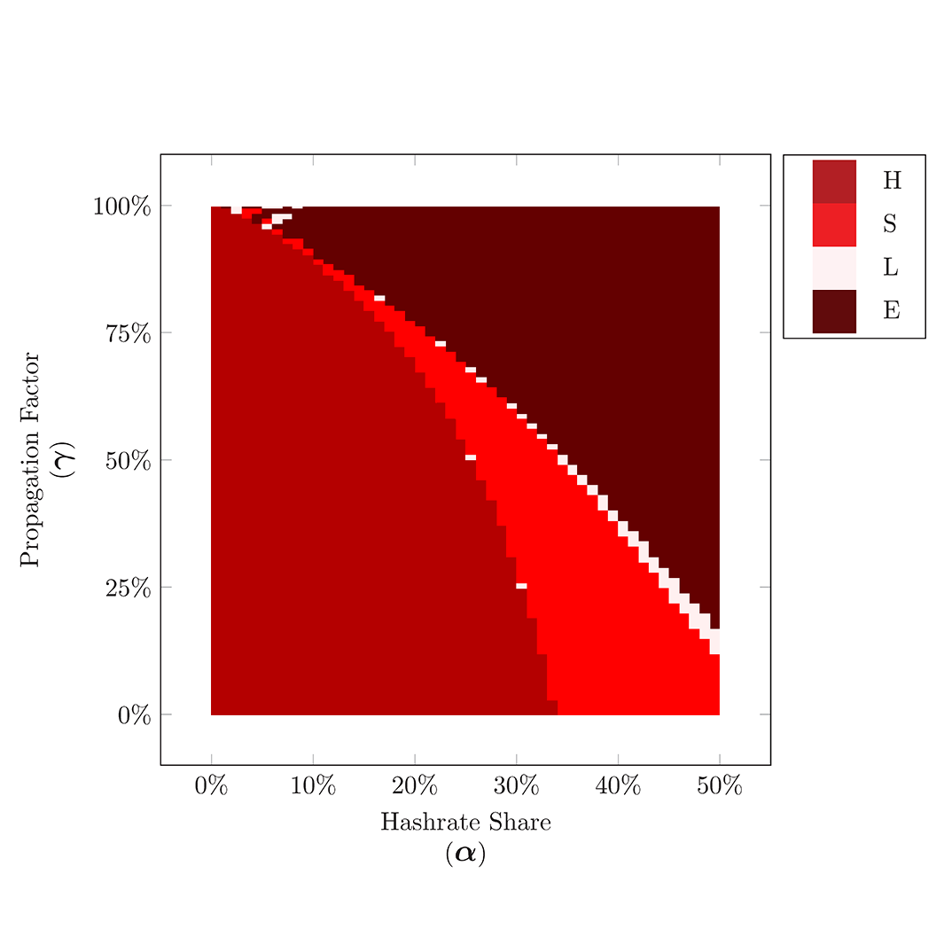

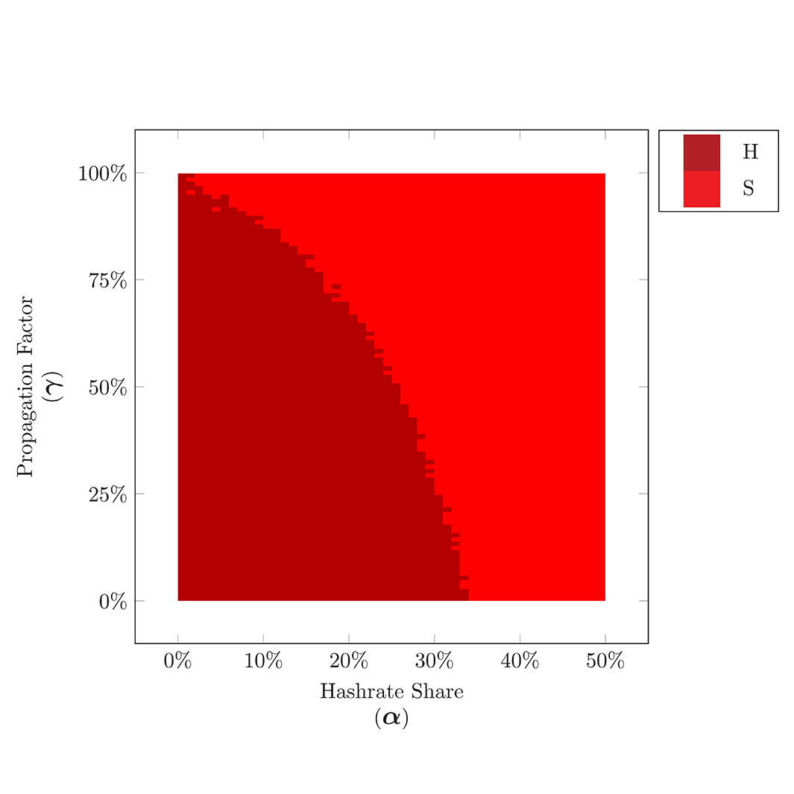
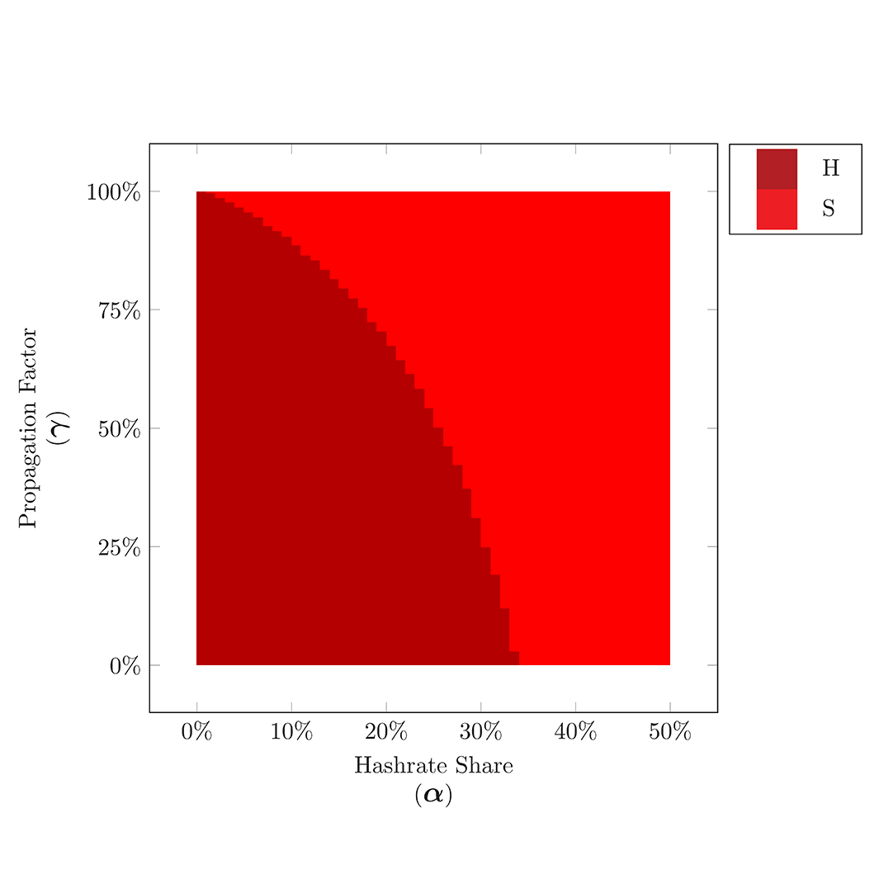
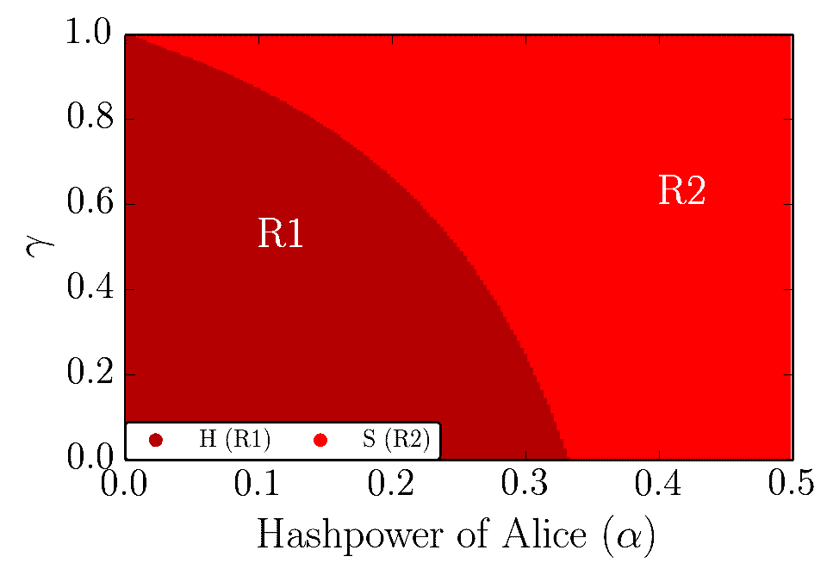


Finite-State Machine Simulations
Peer-to-peer Network Simulation
Average of 100 Executions
Average of 10000 Executions
Average of 100 Executions
Average of 40 Execution
1 Execution
H
S
L
T2
T3
T4
E
Available simulation on the webpage
Available simulation on the webpage
Kartik Nayak et al.
2016
(not available on the webpage)
(not available on the webpage)

